Slide 1

Uber Movement SANRAL Cape Town Challenge
Team 3: Jourdan Louranse Lourdes Devereaux
Yelena Ivanova
Yimiao Zhang

Slide 2
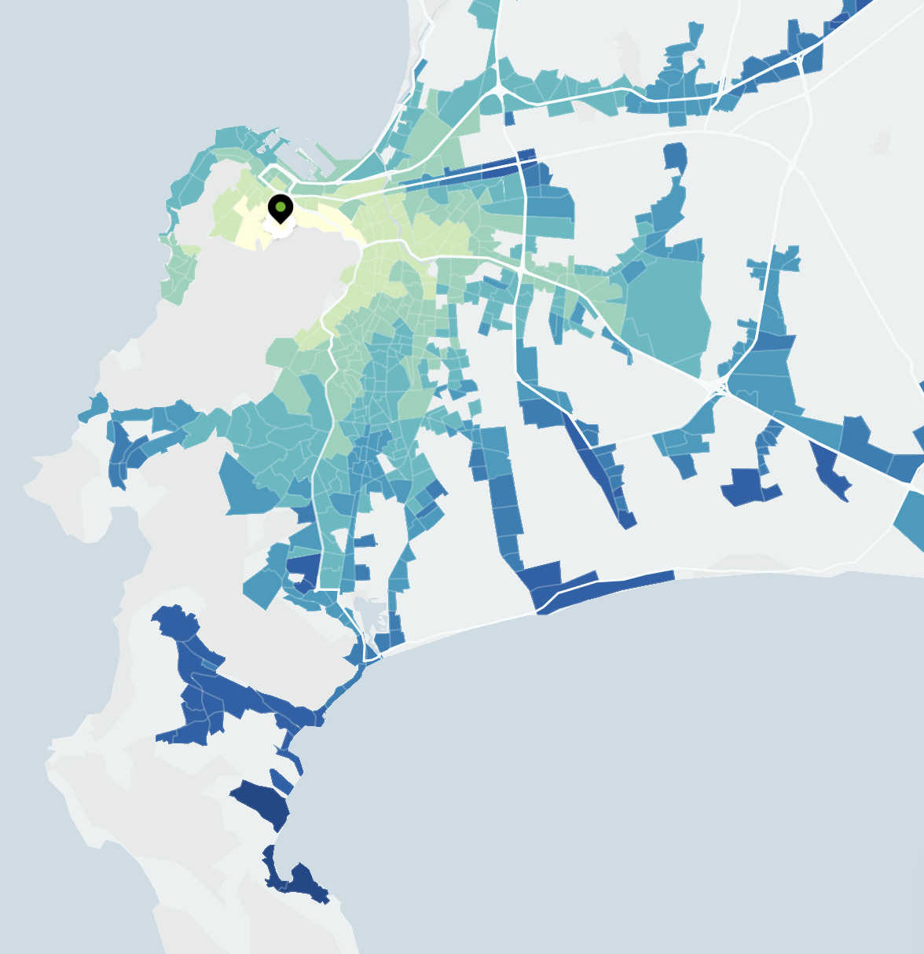
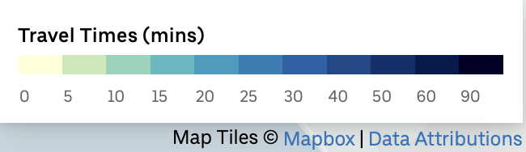
Problem
Forecasting if an incident will occur for each hour of each day per 500 m road segment along the major roadways in Cape Town for 1 January 2019 to 31 March 2019 ¹
Notes:
This is a classification problem

Slide 3
EDA/hypotheses
Additional data: coordinates², weather³, injuries, and vehicles⁴
Visualizations
Notes:
To better understand the problem, we decided to incorporate additional data. We were especially curious about how visibility would affect the accident occurring.
-explanation about nighttime-
Coordinates – to see whether or not there are particular road segments where accidents occur more often.
Injuries and vehicles – to try to finding correlation between smth and smth… idk
Visualisation – to analyse missing data

Slide 4
Model
LightGBM (accuracy, precision, confusion matrix)
CatBoost (log_loss)
F1 score (when p>0.005, y = 1)
Notes:
Since it is a classification problem, will occur – 1, will not – 0.
Tried a number of models, such as
Dealing with really small probabilities – had to put a low threshold

Slide 5
Recommendations
Under-/oversampling
Boosting ensemble
Notes:
Tried to resample the data…

Slide 6
Sources
1. Map of Cape Town. Uber Movement.
2.
3.
4.

